Slide 1



HRAnalytics
View in Power BI
Last data refresh:
4/11/2023 11:05:55 AM UTC
Downloaded at:
4/11/2023 11:15:02 AM UTC

Slide 2
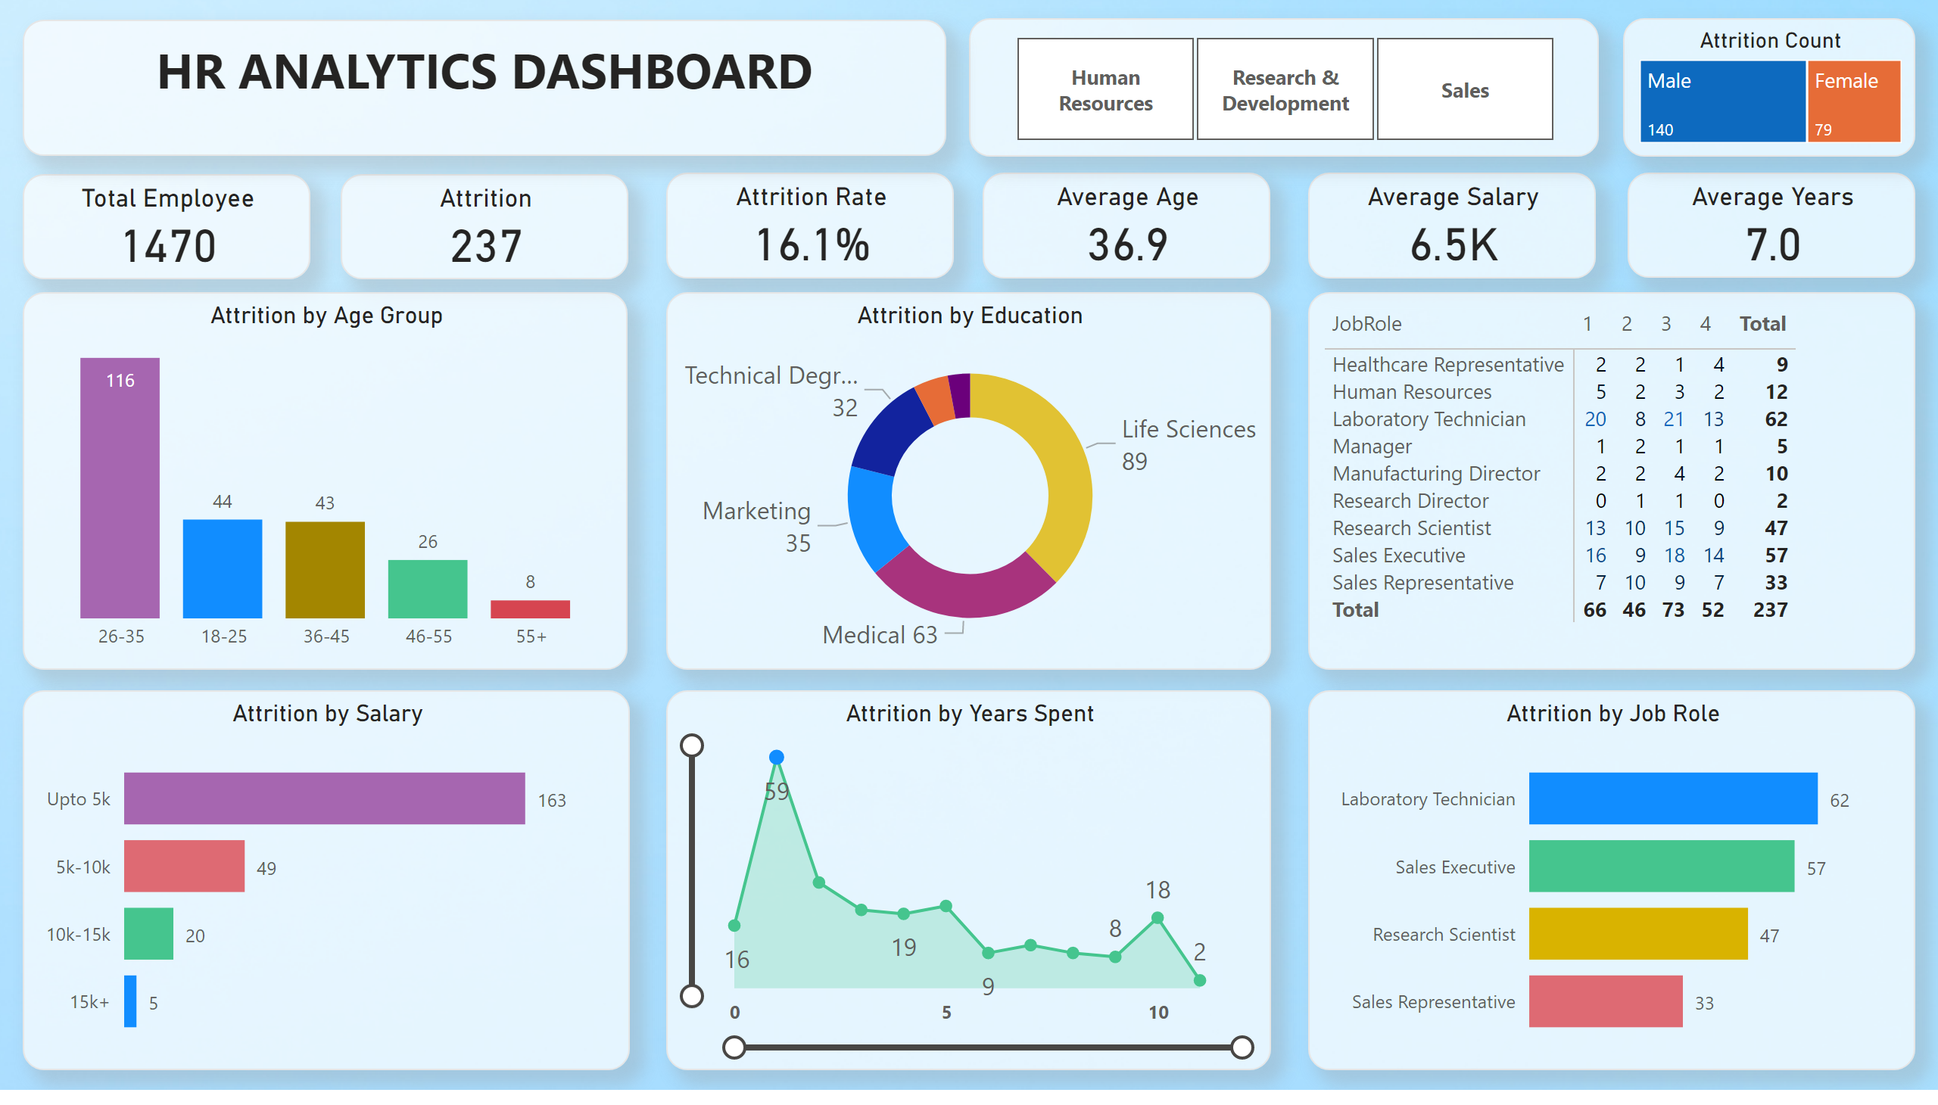
Page 1
Notes:
Total Employee
No alt text provided
Attrition
No alt text provided
Attrition Rate
No alt text provided
Average Age
No alt text provided
Average Salary
No alt text provided
Average Years
No alt text provided
Attrition by Education
No alt text provided
Attrition by Age Group
No alt text provided
pivotTable
No alt text provided
Attrition by Salary
No alt text provided
Attrition by Job Role
No alt text provided
Attrition by Years Spent
No alt text provided
Attrition Count
No alt text provided
slicer
No alt text provided
textbox
No alt text provided

